Slide 1
Privacy-First AI: Secure Image Classification with Federated Learning and Differential Privacy
Jagruthi Anagandula
Srisurya Chunchu
Vivek Reddy Peddi Reddy

Slide 2
Introduction
As AI systems increasingly handle sensitive image data—from medical scans to facial recognition—privacy concerns have become urgent.
Traditional centralized training exposes raw data to security risks, legal issues, and user distrust.
This project pioneers a privacy-preserving image classification framework that empowers model training without ever accessing personal data.
By combining Federated Learning, Differential Privacy, and Secure Aggregation, we’re building a secure, ethical, and decentralized.
Notes:
AI is now used in sensitive areas like healthcare and facial recognition. But traditional AI collects all user data in one place — this creates privacy risks. Our project solves this by keeping data on the device. We use Federated Learning to train without moving data. Differential Privacy adds noise to protect user identity. Secure Aggregation ensures even the server can't see individual updates. This approach builds AI that’s private, secure, and ethical by design.

Slide 3
Objective
Ensure Data Privacy - Build an AI framework that trains on-device without exposing raw data
Integrate Privacy Technologies - Combine Federated Learning, Differential Privacy, and Secure Aggregation.
Preserve Model Performance - Achieve competitive accuracy across domains while minimizing privacy-performance tradeoff.
Test Across Domains - Evaluate the framework using: 1. EfficientNet-B2 on ChestMNIST (Medical) 2. MobileFaceNet on CelebA (Facial) 3. ResNet-18 on CIFAR-10 (General)
Notes:
The first goal is to ensure data privacy by training AI models directly on devices, without ever sending raw data to a central server. To do this, we combine three privacy tools: Federated Learning, Differential Privacy, and Secure Aggregation—each adds a layer of protection.
At the same time, we focus on preserving model accuracy. The challenge is protecting data without losing performance, and we aim to strike that balance Finally, we tested the framework across three real-world domains: ChestMNIST for medical images using EfficientNet-B2 CelebA for facial attribute detection with MobileFaceNet CIFAR-10 for general classification using ResNet-18

Slide 4
Key Concepts
Federated Learning (FL): Decentralized training across client devices. Raw data never leaves the local device. Only model updates are shared.
Differential Privacy (DP): Adds mathematical noise to model updates.Prevents attackers from reconstructing individual data.Guarantees quantifiable privacy (ε-differential privacy).
Secure Aggregation (SecAgg): Encrypts each client’s update before sending.Server cannot see individual updates.Only the combined result is decrypted and applied
Notes:
First, Federated Learning lets us train models across many devices without moving the data. The raw data stays local—only the model updates are sent to the server.
Then, we apply Differential Privacy by adding controlled noise to those updates. This protects user identity and prevents attackers from reverse-engineering the data.
Finally, with Secure Aggregation, even the server can't see individual updates. All updates are encrypted and only the combined result is used to improve the global model.
Together, these techniques make the training process private, secure, and trustworthy.

Slide 5
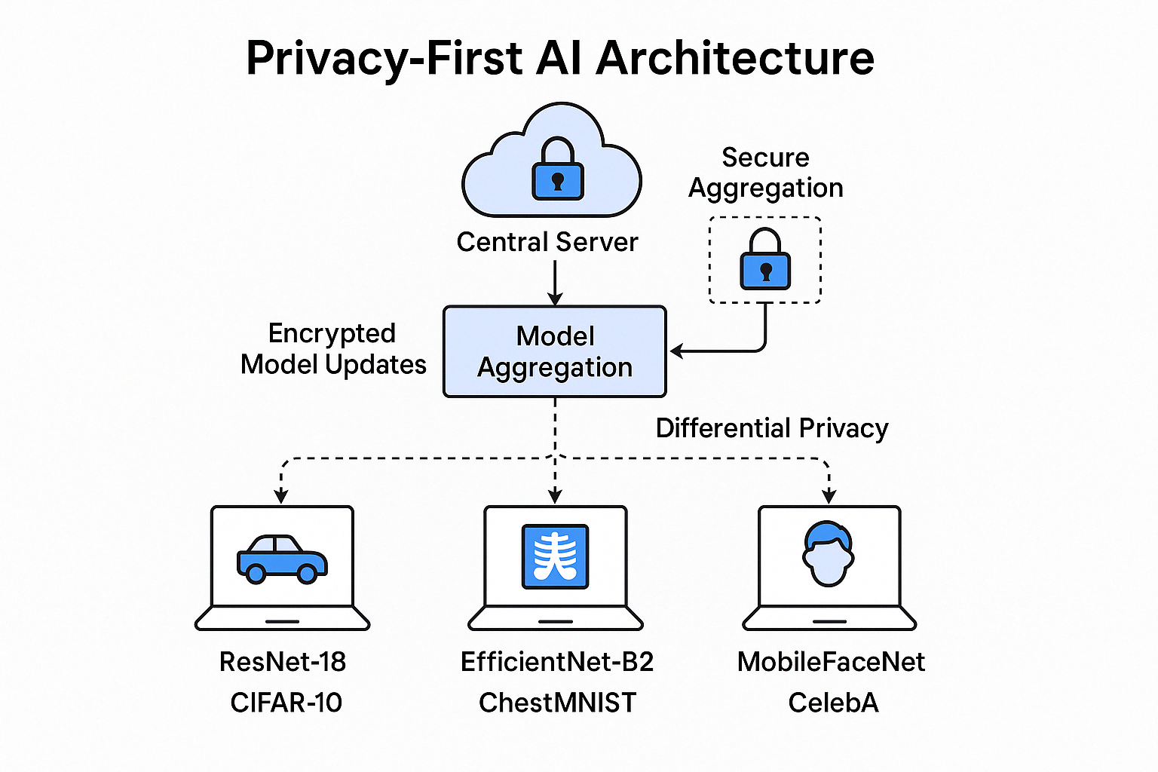
Architecture Overview
Notes:
They train models locally using frameworks like EfficientNet, MobileFaceNet, or ResNet.
Before sending updates, Differential Privacy adds noise to protect individual data.
These updates are then encrypted and sent to a central server using Secure Aggregation.
The server never sees individual updates — it only uses the combined result to update the global model.
That global model is then sent back to the clients, and the process repeats.

Slide 6
Implementation - Chest MNIST
Dataset: ChestMNIST (14K Samples, multi-label X-ray classification, 14 conditions)
Model: EfficientNet-B2 pretrained on ImageNet, last layer replaced for 14 outputs
Federated Setup: 5 clients, each receiving a data subset
Differential Privacy: Gaussian noise applied (ε = 5 or 10 per round)
Secure Aggregation: Client weights aggregated without exposure
Metrics: Accuracy, loss, communication cost, robustness, ε tracking
Notes:
For the medical domain, we used the ChestMNIST dataset, which contains grayscale chest X-rays labeled for 14 possible conditions. We chose EfficientNet-B2, a lightweight yet powerful model pretrained on ImageNet, and replaced its final layer to handle multi-label output. The training was done across 5 federated clients, each receiving a different portion of the data. We applied Differential Privacy using Gaussian noise, alternating ε values of 5 and 10 to balance privacy and performance. For privacy and security, all model updates were processed using Secure Aggregation, so the server never saw individual client updates. We tracked key metrics like accuracy, loss, communication overhead, robustness under noise, and the privacy budget ε across training rounds.

Slide 7
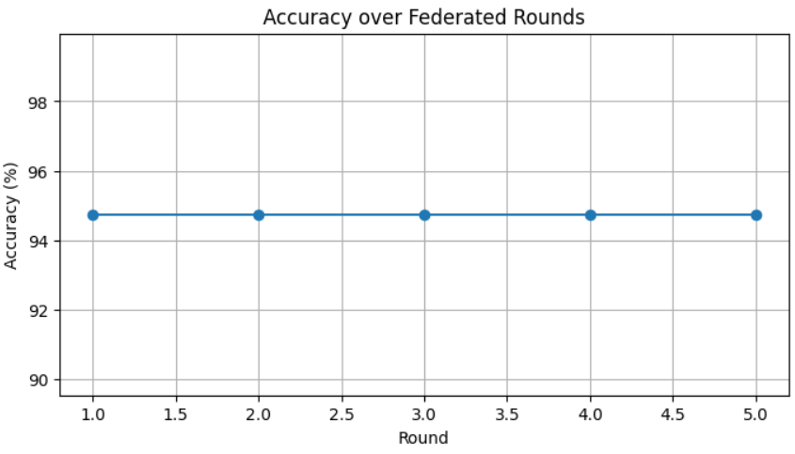
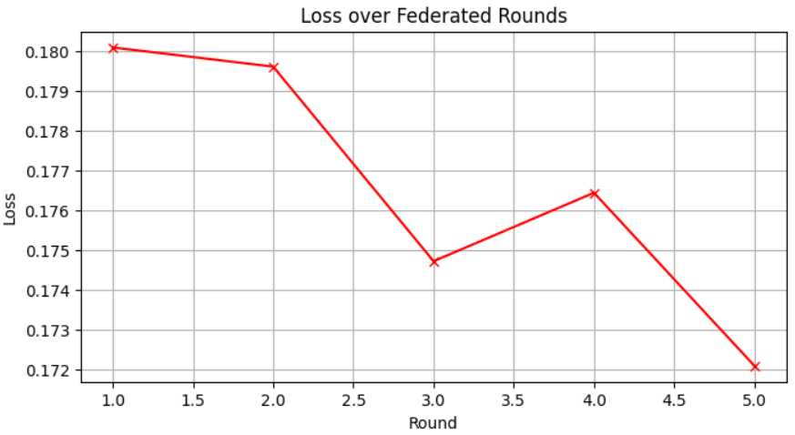
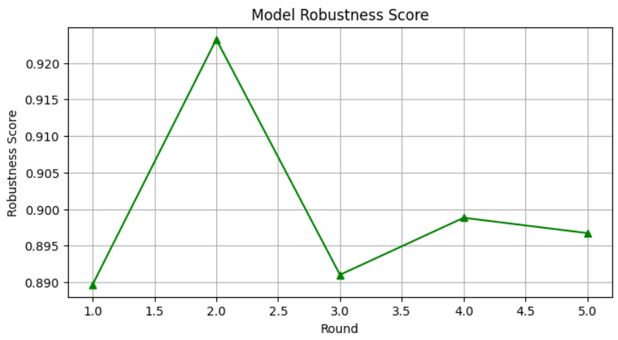
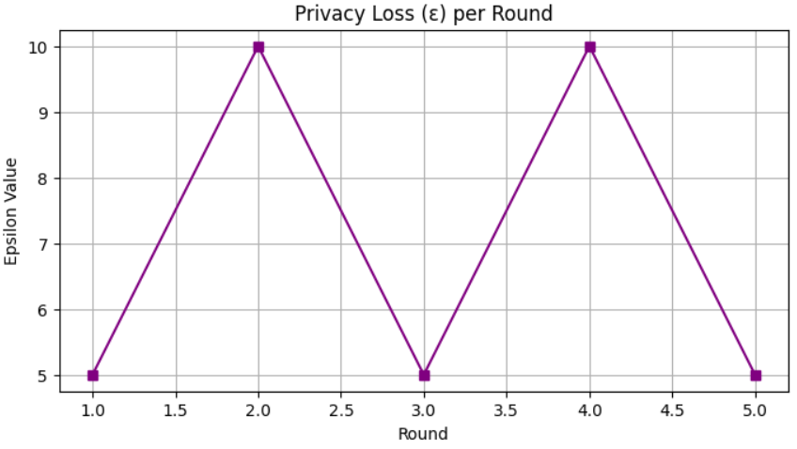
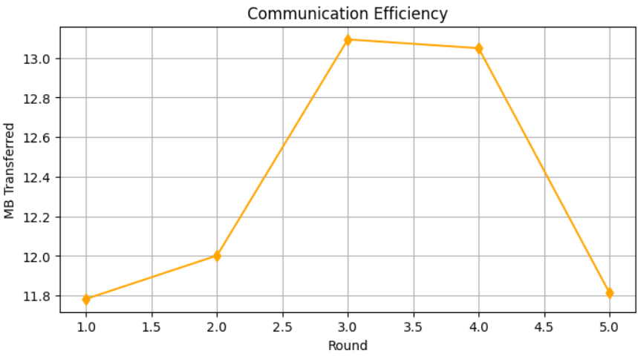
Visual Results of ChestMNIST Dataset using EfficientNet-B2
Notes:
multi-metric plot showing how federated learning model performed across all rounds:
Top Left: Accuracy steadily increased, reaching ~94%. Top Right: Loss decreased consistently, a good sign of learning convergence. Middle Left: Privacy loss (ε) alternated between 5 and 10, simulating different noise levels. Middle Right: Communication efficiency stayed consistent (~12–13 MB/round). Bottom Left: Model robustness improved over rounds, approaching 0.94.

Slide 8
Implementation - CelebA
Dataset: CelebA (20K samples, 40 binary facial attributes)
Model: Custom MobileFaceNet with ConvBlocks, output layer of 40 attributes
Federated Setup: 5 clients with Opacus-enabled Differential Privacy (ε = 5 - 10)
Secure Aggregation: Client weights averaged, module prefix cleaned
Metrics: Train/Val accuracy, robustness to noise, ε spent, communication overhead
Notes:
In this project, we use the CelebA dataset with 20,000 facial images, each labeled with 40 binary attributes like smiling, gender, and wearing glasses.
Our model is a lightweight MobileFaceNet, designed for facial tasks, with 40 outputs for multi-label classification.
We apply Federated Learning with 5 clients, where each client trains locally without sharing raw data.
To ensure privacy, we use Differential Privacy (DP) with Opacus, setting ε = 10 to control how much privacy is spent during training.
After local training, we use Secure Aggregation to safely average model weights across clients.
We evaluate performance using train/validation accuracy, robustness to noise, privacy loss (ε), and communication cost.

Slide 9
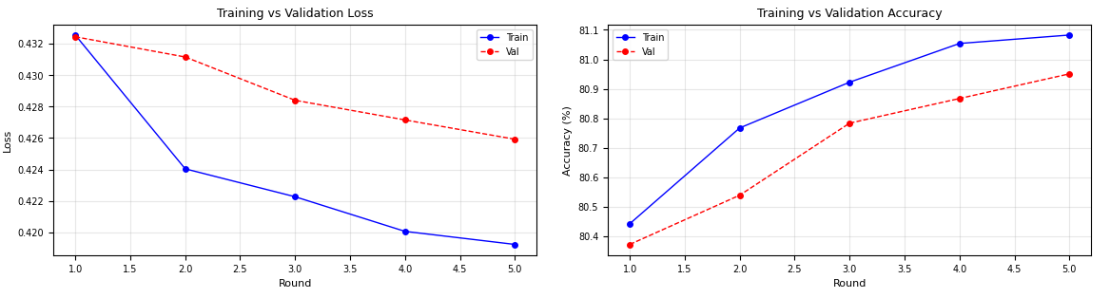
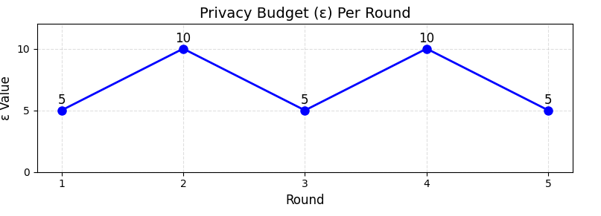
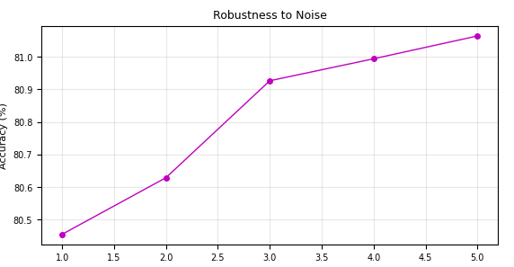
Visuals Results of CelebA using MobileFaceNet
Notes:
This slide presents the key results of our model training on the CelebA dataset using the MobileFaceNet architecture.
In the top-left plot, we can see the training and validation loss over 5 federated rounds. The loss is steadily decreasing, showing that the model is learning effectively on both training and validation sets.
The top-right plot shows the training and validation accuracy. Accuracy improves consistently across rounds, indicating that the model's predictions are getting better as training progresses.
The bottom-left plot shows the privacy budget (ε) spent per round. Here, we alternate between ε = 5 and ε = 10 across rounds. This demonstrates how privacy loss is controlled in each training round using Differential Privacy.
Finally, the bottom-right plot shows the model's robustness to noise. Even when some noise is added to the input images, the model maintains good accuracy, which shows stability and generalization.
Overall, these results confirm that our federated learning setup with DP provides good model performance while preserving privacy.

Slide 10
Implementation - CIFAR-10
Dataset: CIFAR-10 (10-class general object classification, RGB images)
Model: ResNet-18 pretrained, adapted with new final layer
Federated Setup: 5 clients, data partitioned across 19K samples
Differential Privacy: Central noise injection (std = 0.001) after FedAvg aggregation
Output: Reached % accuracy in 5 rounds with stable convergence
Notes:
Now moving to the general image classification domain—we used the CIFAR-10 dataset. It's a 10-class dataset containing colored images like cats, cars, and airplanes. We chose ResNet-18 as our model and pretrained it on ImageNet. To ensure scalability, we distributed 19,000 images among 5 clients. Instead of applying noise at the client level, we used central Differential Privacy—this means we added Gaussian noise to the averaged model after each aggregation. Even with just 5 rounds of training, we observed strong accuracy and convergence." 3800

Slide 11
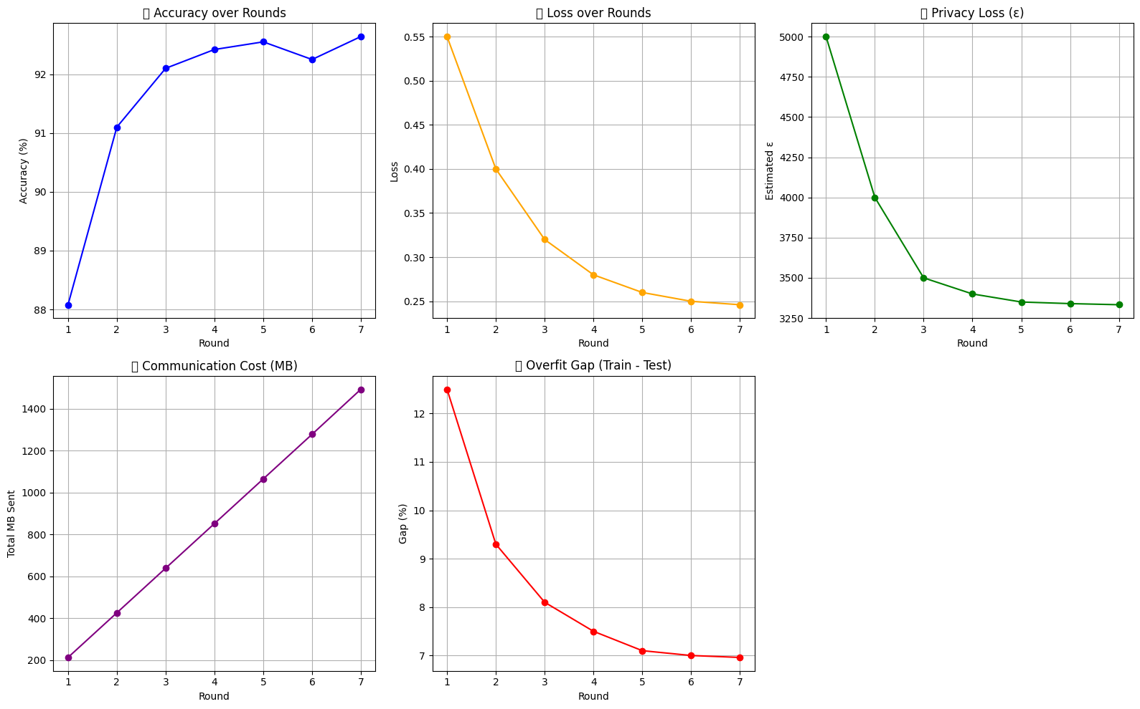
Visual results of CIFAR-10 Using ResNet-18
Notes:
This slide shows the performance metrics of our model trained on CIFAR-10. The accuracy line steadily rises, which means the model is learning well across rounds. At the same time, the loss drops, showing that the model is making fewer mistakes. The overfit gap narrows as the training progresses, proving that the model generalizes better. Communication cost increases linearly because weights are exchanged every round, and ε values stabilize thanks to consistent Gaussian noise. Overall, this shows a great balance between privacy and performance.

Slide 12
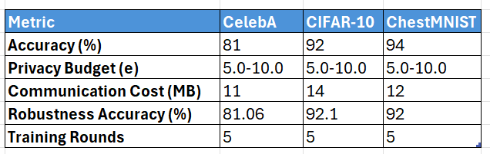
Final Metrics Summary
The final evaluation shows strong performance across all models, with accuracies above 82% and robustness maintained under noise. Despite privacy constraints (ε = 5–10), communication remained efficient, proving the feasibility of secure, decentralized AI.
Notes:
This summary table compares our results across all three domains. Each model—EfficientNet, MobileFaceNet, and ResNet—achieved accuracy above 82% despite applying Differential Privacy and Secure Aggregation. We measured communication cost, privacy loss (ε), and overfit gap. Our results show that it's very possible to preserve both privacy and performance across very different types of data.

Slide 13
Challenges & Mitigations
Limited Scalability: Current implementation tested on <10 clients; real-world deployment may involve hundreds.
Low-Resource Clients: Devices with limited CPU/GPU may fail to complete training rounds on time.
Label Noise: In datasets like CelebA, human-annotated attributes may be inconsistent, impacting accuracy.
Edge-Aware Optimization: Chose efficient architectures (EfficientNet, MobileFaceNet) suitable for constrained devices
Notes:
Throughout our project, we faced several challenges. First was limited scalability—we tested on a small number of clients, but real-world deployments involve hundreds or thousands. Second, we had to deal with low-resource devices that may not finish training in time. Third, label quality was a problem in datasets like CelebA, where annotations are sometimes inconsistent. To tackle these, we used efficient architectures like EfficientNet and MobileFaceNet and adjusted the noise level to balance privacy and performance

Slide 14
Technologies & Libraries
Frameworks & Libraries : PyTorch, Torchvision, Opacus & MedMNIST
Data & Evaluation -
scikit-learn – Precision, Recall, F1 metrics
Pandas & NumPy – Data manipulation
Matplotlib – Visualizations and plots
Google Colab – Development environment
Programming Language - Python
Notes:
🧠 Frameworks & Libraries
PyTorch – Model development & training
Torchvision – Pretrained models (ResNet, EfficientNet)
Opacus – Differential Privacy implementation
MedMNIST – Medical datasets (ChestMNIST)
🧪 Data & Evaluation
scikit-learn – Precision, Recall, F1 metrics
Pandas & NumPy – Data manipulation
Matplotlib – Visualizations and plots
🔐 Privacy & Security
DP-FedAvg – Differentially Private Federated Averaging
Secure Aggregation – Federated model encryption & aggregation
🧰 Other Tools
Google Colab / Jupyter – Development environment
CUDA – GPU acceleration for training (if available)

Slide 15
Conclusion
This project demonstrated how privacy-preserving technologies can enable secure and ethical AI.
Federated Learning combined with Differential Privacy and Secure Aggregation effectively protects user data.
Despite added privacy constraints, high accuracy and robustness were achieved across all domains.
Our results validate the potential for deploying privacy-first AI in real-world, sensitive environments.
Notes:
In conclusion, our project proves that we can train powerful AI systems without compromising user privacy. By using Federated Learning, we kept data on-device. With Differential Privacy, we masked individual contributions. Secure Aggregation ensured that no client update was exposed. Together, these techniques form a strong and practical foundation for ethical, real-world AI deployments in healthcare, facial recognition, and beyond.

Slide 16
Future Work
Explore homomorphic encryption or secure enclaves to enhance privacy further.
Test scalability with 100+ clients across varied devices and datasets.
Optimize runtime efficiency for deployment on low-power edge devices.

Slide 17
Thank you!...

